Slide 1
Upper GI Disorders
Zoya Khan, DO
Internal Medicine – Lakeland Regional Health

Slide 2
Learning Objectives
Explain normal esophageal anatomy, motility & anti-reflux physiology
Explain the pathophysiology of major esophageal disorders
Recognize alarm features
Differentiate mechanical from motility related dysphagia
Select the appropriate initial diagnostic test
Develop initial evidence-based medicine plans
Stabilize and evaluate patients with upper GI bleeding

Slide 3
Lecture Roadmap
Esophageal anatomy & physiology
Dysphagia evaluation
GERD & Barrett’s esophagus
Esophagitis & strictures
Motility disorders
Upper GI Bleeding
Peptic Ulcer Disease
High Yield Comparisons
Zenker Diverticulum

Slide 4
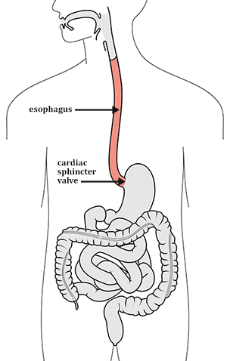
Esophageal Anatomy & Histology
25 cm from upper esophageal sphincter → gastric cardia
Upper 1/3: skeletal muscle
Middle 1/3: mixed skeletal + smooth
Lower 1/3: smooth muscle
Lined by nonkeratinized stratified squamous epithelium
No serosa → perforation/mediastinal spread can be clinically severe
This Photo by Unknown Author is licensed under CC BY-SA-NC

Slide 5
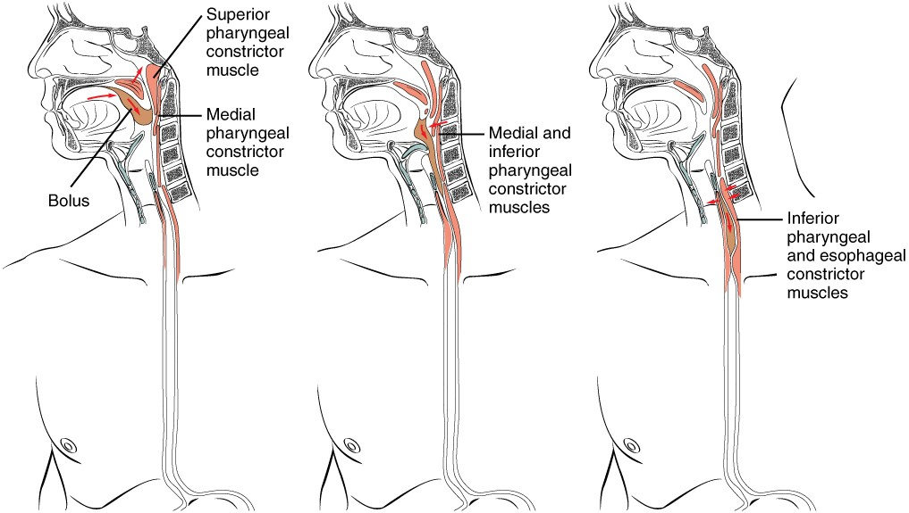
Normal Swallowing & Anti-Reflux Physiology
Swallowing phases:
Oral = voluntary bolus prep
Pharyngeal = airway protection + upper sphincter relaxation
Esophageal = primary peristaltic propagation
Coordinated by Vagus nerve
Excitatory = Cholinergic neurons (ACh)
Inhibited by myenteric neurons (Release NO + VIP)
Anti-reflux barrier:
Lower esophageal sphincter (LES) pressure
Crural diaphragm
Intra-abdominal esophageal segment
Clearance: peristalsis + gravity

Slide 6
Common Symptoms
Heartburn
Regurgitation
Dysphagia
Odynophagia
Food Impaction
Non-cardiac chest pain
Hematemesis or melena
Chronic cough, hoarseness or throat clearing
Aspiration or recurrent pneumonia

Slide 7
Dysphagia
Oropharyngeal
Difficulty initiating a swallow
Coughing, choking, nasal regurgitation
Wet/gurgling voice
Cause: neurologic or neuromuscular disease
Esophageal
Swallowing begins normally → food feels stuck after swallowing
Causes: structural or motility disorder

Slide 8
Dysphagia: Solids vs Liquids?
Solids first:
Peptic stricture
Schatzki ring
Eosinophilic esophagitis
Malignancy
Solids & Liquids:
Achalasia
Diffuse esophageal spasm
Functional dysphagia
Intermittent solids
Rings
Eosinophilic esophagitis
Intermittent food bolus obstruction

Slide 9
Dysphagia: Alarm Symptoms
Progressive dysphagia
Odynophagia
Unintentional weight loss
Overt GI bleeding
Iron-deficiency anemia
Persistent Vomiting
Early satiety
Family hx of upper GI malignancy
Persistent adenopathy
Current ASGE guidelines:
GERD + dysphagia, odynophagia, wt loss, bleeding, vomiting, unexplained iron-deficiency anemia = get EGD!

Slide 10
Dysphagia: History
Onset:
Acute vs. subacute vs. chronic
Progression vs. intermittent
Dysphagia to solids, liquids or both?
Food impactions
Atopy or asthma
Medications associated with pill esophagitis (NSAIDs, iron, bisphosphonates)
Immunosuppression
Alcohol use
Prior radiation, caustic injury or surgery

Slide 11
Dysphagia: Examination
Hemodynamic status
Signs of malnutrition → temporal wasting, cachexia, scaphoid abdomen
Mouth → oral candidiasis
Neck → cervical masses/lymphadenopathy
Neurologic findings → swallowing difficulty
Lungs → evidence of aspiration
Stigmata of chronic liver disease → jaundice, spider angiomata, gynecomastia

Slide 12
Dysphagia: Diagnostic Tools
EGD
Checks for: mucosal dz, obstruction, malignancy, bleeding
Allows biopsy & therapy
Barium esophagram
Checks: structural anatomy
Rings, diverticula, severe strictures, achalasia
Esophageal manometry
Checks: Esophageal motor function
Achalasia, other motility disorders
Ambulatory pH monitoring
Establishes/quantifies reflux

Slide 13
Dysphagia: Diagnostic Pathway
Determine oropharyngeal vs. esophageal
Identify alarm symptoms → EGD
Persistent esophageal dysphagia → EGD
Add barium esophagram if:
Zenker diverticulum suspected
Subtle ring
If EGD does not explain dysphagia → esophageal manometry
Consider CT or endoscopic ultrasound when malignancy suspected

Slide 14
GERD & Barrett’s Esophagus

Slide 15
GERD & Barrett’s Esophagus
When reflux of gastric contents produces troublesome symptoms
Common phenotypes:
Non-erosive reflux
Erosive esophagitis
Barrett’s esophagus

Slide 16
GERD Pathophysiology
Failure of anti-reflux barrier:
Transient LES relaxation
Hiatal hernia separating LES from the diaphragm
Increased intra-abd pressure (obesity)
Delayed gastric emptying
Mucosal sensitivity & impaired epithelial function
Causes of ↓ LES tone:
Coffee
Tobacco
Alcohol
CCBs
Nitrates

Slide 17
GERD: Clinical Presentation
Typical sx:
Heartburn
Regurgitation
Postprandial or positional symptoms
Extra-esophageal manifestations
Chronic cough
Laryngitis
Asthma exacerbation
Dental erosions
Avoid assuming GERD; r/u pulm/ENT/allergy causes first!

Slide 18
GERD: Diagnosis
Classic sx:
Empiric once-daily PPI therapy x8 weeks
Ensure no alarm symptoms!
Perform EGD if:
+alarm sx
Severe/refractory sx
If EGD normal → pH monitoring

Slide 19
GERD: Management
Long Term PPI Risks:
Hypomagnesemia
Dec. B12 absorption
Dec. Bone density
Initial:
Weight reduction (if obese)
Lifestyle changes:
Elevate head of bed
Avoid meals 2-3 hours before bedtime
Avoid acidic/spicy foods
Tobacco cessation
Start PPI x8 weeks
30-60 mins before meals (usually before breakfast)
Continue if:
Erosive esophagitis
Barrett’s esophagus
Recurrent peptic stricture

Slide 20
GERD: Long-Term Complications
Erosive esophagitis
Ulceration
Peptic stricture
Barrett’s esophagus
Esophageal adenocarcinoma

Slide 21
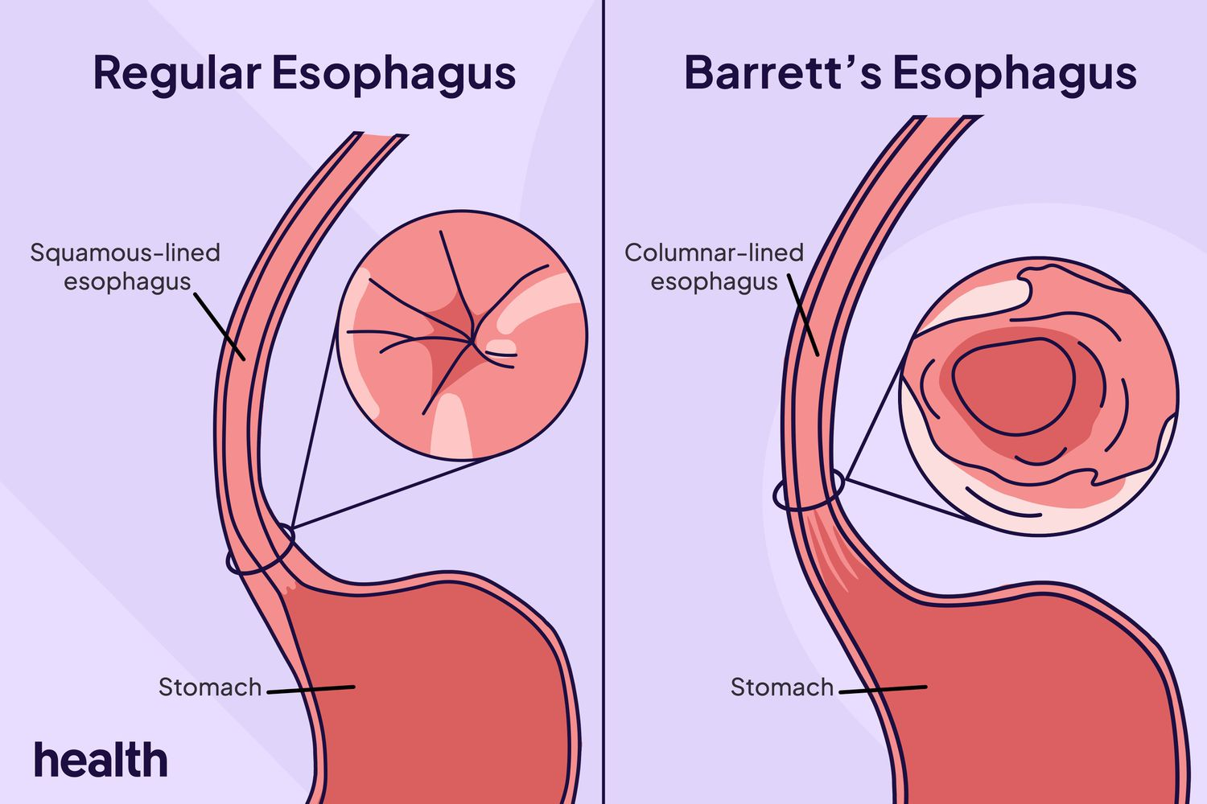
Barrett’s Esophagus: Pathophysiology
Chronic reflux → acid/bile reaches squamous mucosa →
Normal squamous → columnar epithelium
Progression sequence
Intestinal metaplasia → low-grade dysplasia → high-grade dysplasia → intramucosal adenocarcinoma → invasive adenocarcinoma
Molecular abnormalities: p53 pathway
Notes:
Columnar epithelium is intestinal epithelia

Slide 22
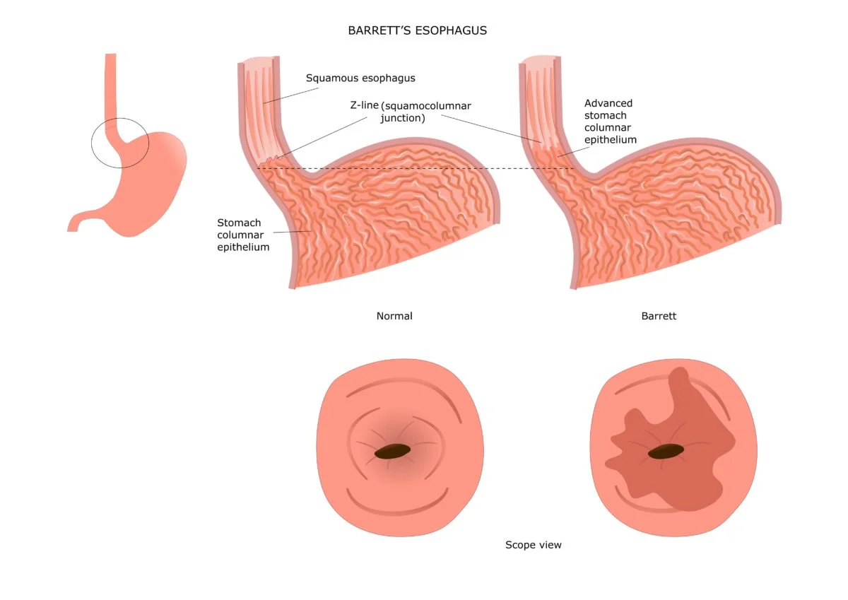
Barrett’s Esophagus: Screening
High risk population:
male
>50 y/o
White
Tobacco
Obesity
1st degree family relative w/ Barrett’s or
esophageal malignancy
EGD in:
Chronic GERD
Notes:
Columnar epithelium is intestinal epithelia

Slide 23
Barrett’s Esophagus: Diagnosis
EGD:
Visible columnar mucosa in the esophagus
Histology intestinal metaplasia
Notes:
Columnar epithelium is intestinal epithelia

Slide 24
Barrett’s Esophagus: Management
Nondysplastic Barrett’s
Daily PPI
If <3cm: rpt EGD q5y
If >3cm: rpt EGD q3y
Low-grade dysplasia:
High-grade dysplasia OR cancer:
Surgery if resectable
Endoscopic resection
Endoscopic resection + ablation
Notes:
Columnar epithelium is intestinal epithelia

Slide 25
Esophagitis & Strictures

Slide 26
Esophagitis & Strictures
Types:
Reflux esophagitis
Eosinophilic Esophagitis (EoE)
Pill-induced Esophagitis
Infectious Esophagitis
Radiation Esophagitis
Caustic injury
Clinical clues:
Heartburn → suggest reflux
Odynophagia → suggests mucosal injury
Food impaction → EoE or structural narrowing

Slide 27
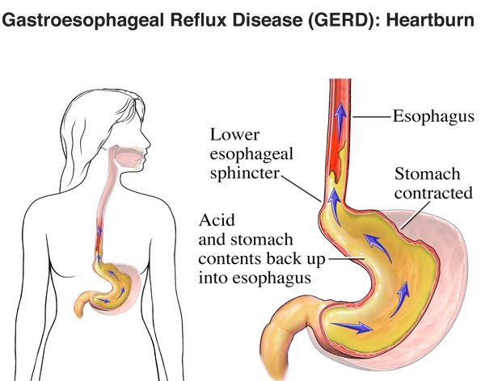
Reflux Esophagitis
Pathophysiology
Prolonged acid + pepsin contact
Disruption of epithelial tight junctions
Erosions → ulceration, bleeding, fibrosis, Barretts
Endoscopic Grading
Los Angeles Grades A-D
C-D indicate severe mucosal injury
Treatment:
PPI therapy
If grade C-D, will need long term maintenance
Rpt EGD after 8 weeks/healing to eval for Barrett’s

Slide 28
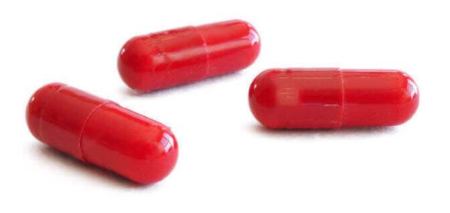
Pill-Induced Esophagitis
Pathophysiology
Tablet lodges at anatomic narrowing
Prolonged mucosal contact → direct injury
Common Medications
Tetracyclines
Bisphosphonates
Potassium chloride tabs
Iron supplements
NSAIDs
Clindamycin
Presentation:
Sudden odynophagia
Retrosternal pain
Dysphagia
Management:
Stop the offending drug
PPI + supportive care
Take pills upright with water

Slide 29
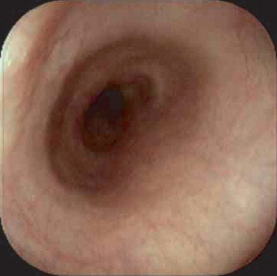
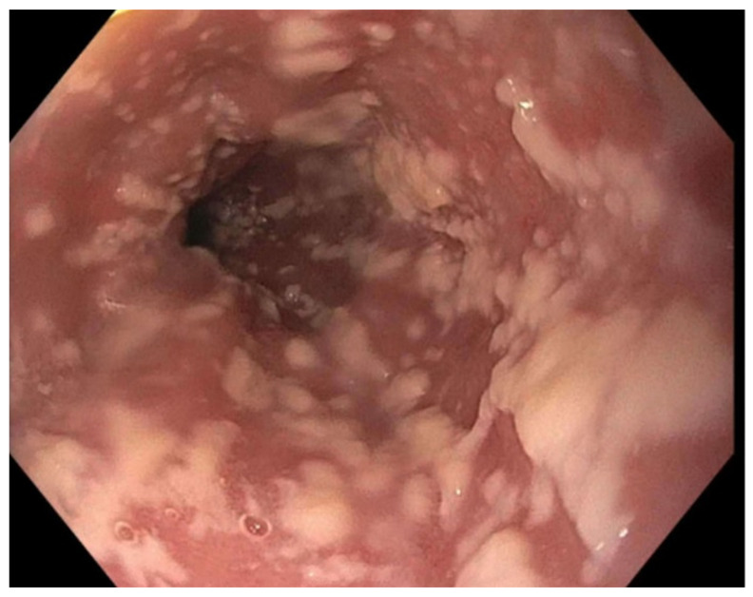
Infectious Esophagitis
Risk Factors:
Advanced HIV
Transplant
Chemotherapy
Chronic Steroids
Severe Immunosuppression
Candida
White adherent plaques
+/- oral thrush
- Tx: PO fluconazole
Normal
Candida

Slide 30
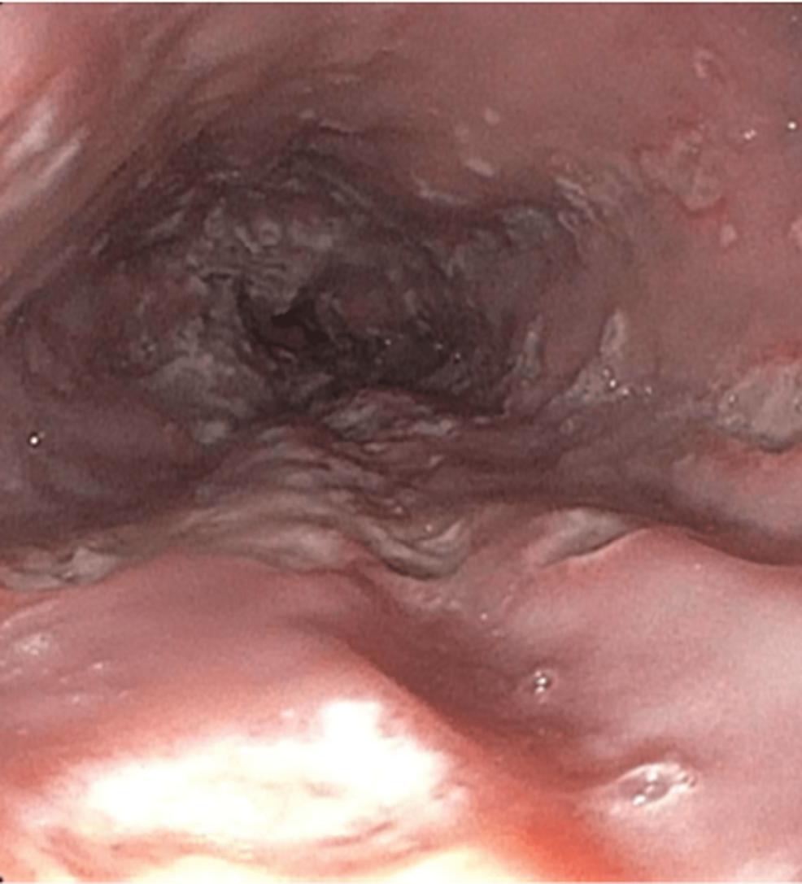
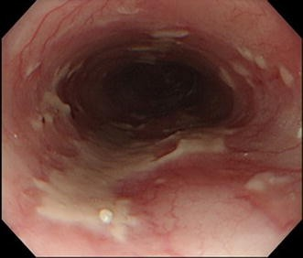
Infectious Esophagitis
HSV
Multiple small “volcano like” ulcers
Tx: acyclovir
CMV
Large, linear longitudinal ulcers
Tx: ganciclovir or valganciclovir
HSV
CMV

Slide 31
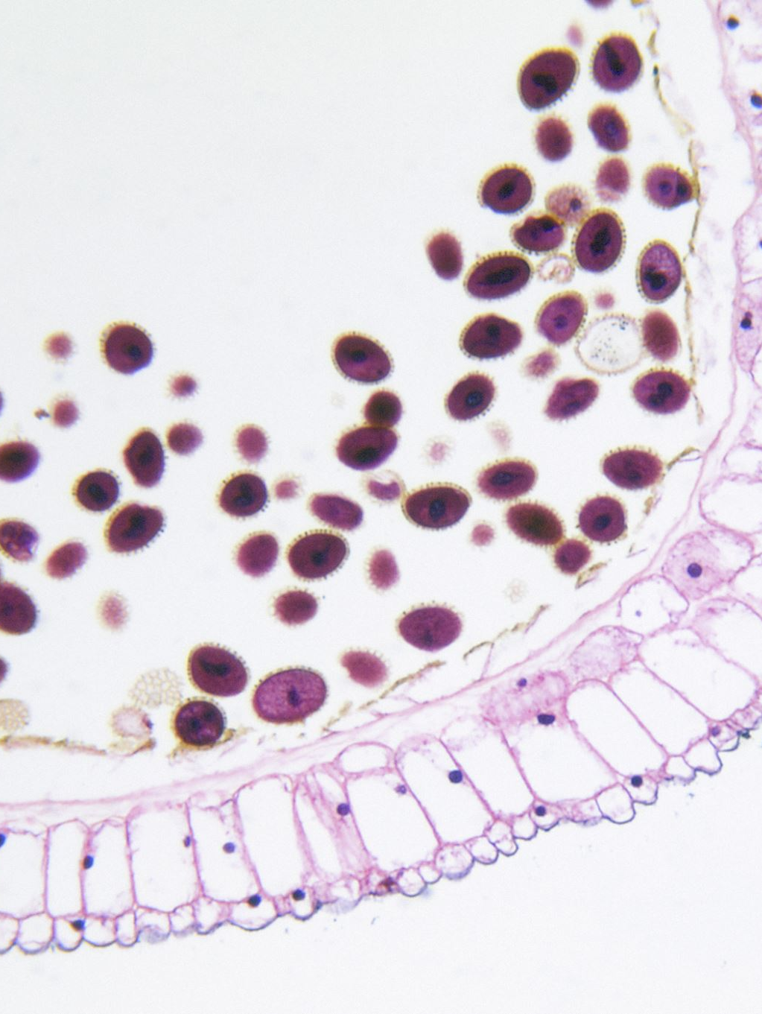
Eosinophilic Esophagitis (EoE)
Pathophysiology:
Chronic, antigen-driven immune-mediated disease
Food/environmental allergies activate:
Th2 lymphocytes → IL-4, 5 and 13 → recruitment of eosinophils → epithelial injury
Chronic inflammation → activates fibroblasts
Causes: rings, strictures, dec. distensibility

Slide 32
Eosinophilic Esophagitis (EoE): Presentation
Adults: dysphagia & food impaction
Children: feeding difficulty, vomiting, abd pain, poor growth
Atopic disease is common!

Slide 33
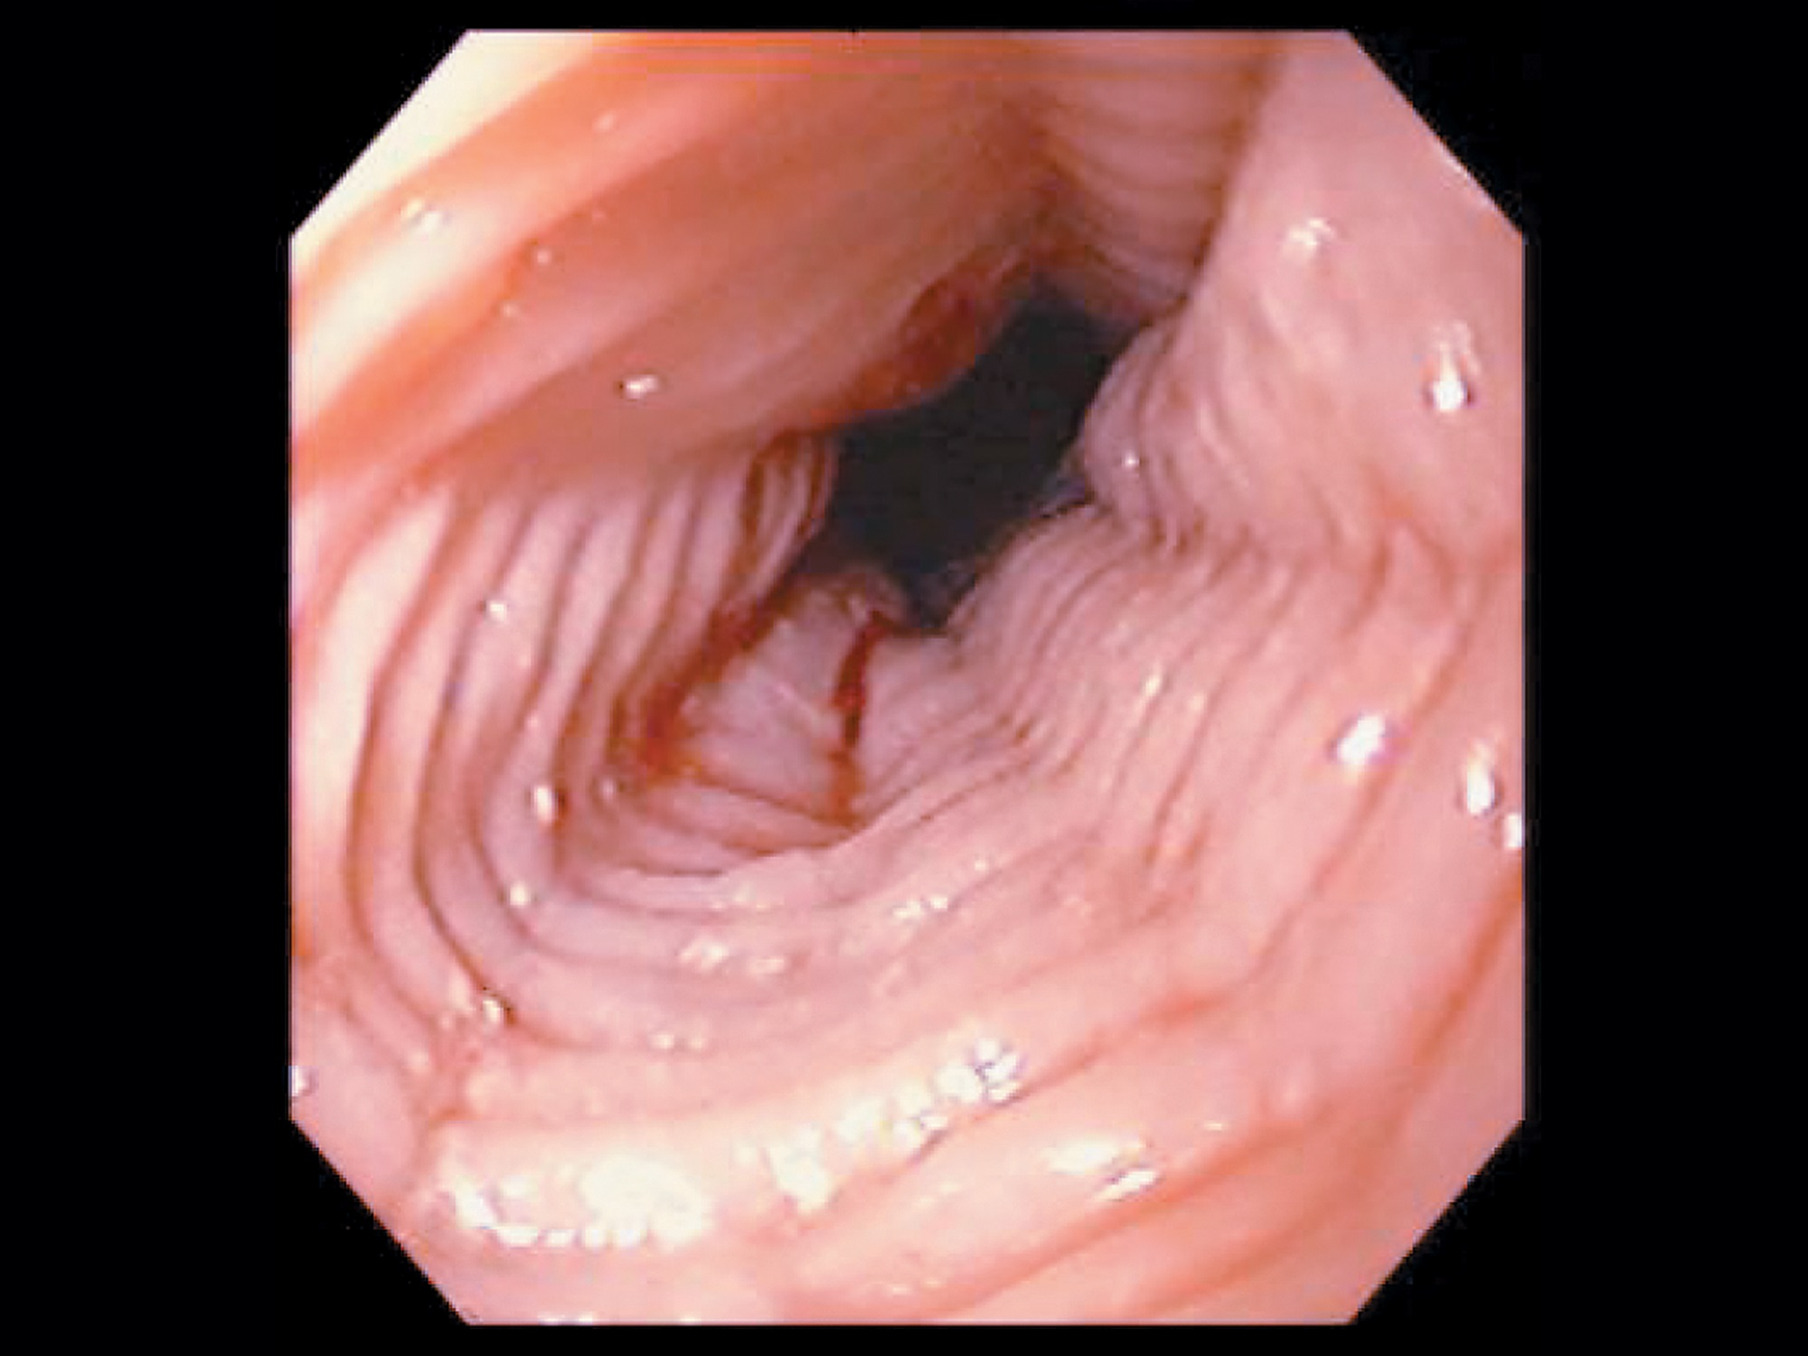
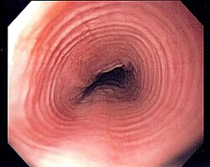
Eosinophilic Esophagitis (EoE): Diagnosis
EGD:
Rings, linear furrows
White exudates
Edema w/ loss of vascularity
Note: endoscopy can appear normal as well!

Slide 34
Eosinophilic Esophagitis (EoE): Treatment
PPI
Swallowed Steroids:
Budesonide
Fluticasone
Food-elimination diet:
Start w/ 1-2 restrictions to identify
Treatment resistant disease: Dupilumab
If +strictures/narrowing: endoscopic dilation

Slide 35
Esophageal Strictures

Slide 36
Esophageal Strictures
Pathophysiology:
Persistent epithelial injury → inflammation → fibroblasts → collagen remodeling → lumen progressively narrows
Etiologies:
Chronic acid reflux
EoE
Radiation
Caustic ingestions
Medication injury
Malignancy

Slide 37
Esophageal Strictures: Presentation
Progressive solid-food dysphagia
Food impaction
Weight loss (if advanced)
When very severe → liquid dysphagia

Slide 38
Esophageal Strictures: Evaluation
EGD w/ biopsy
Barium esophagram if:
Proximal narrowing suspected
Anatomy is uncertain
CT chest/abdomen when extrinsic malignancy suspected

Slide 39
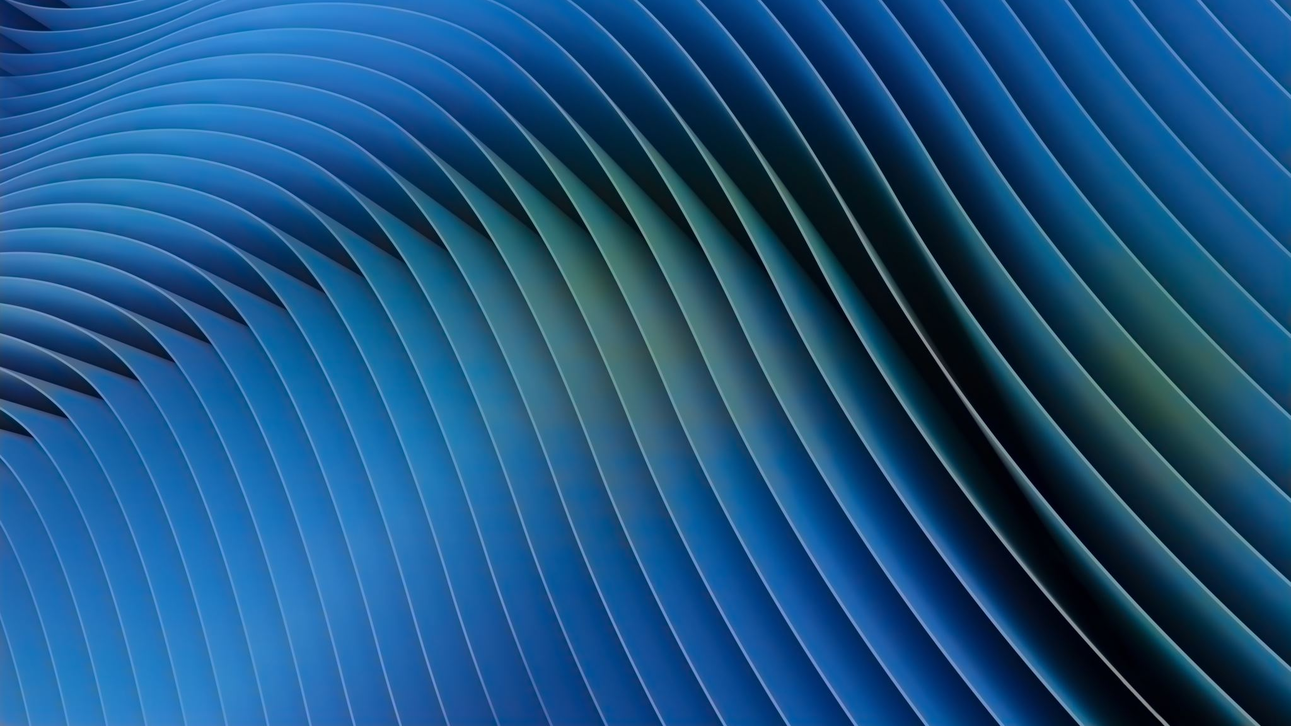
Esophageal Strictures: Treatment
Tx the underlying cause!
PPI for peptic strictures
Steroids for EoE
Endoscopic balloon or dilation
Always counsel about perforation risk!

Slide 40

Rings & Webs
Schatzki Ring
Thin, circumferential mucosal ring
Sometimes assoc w/ reflux and EoE
Sx: intermittent solid dysphagia
“steakhouse syndrome”
Tx: dilation
Esophageal Webs
Thin, cervical mucosal membranes
May be assoc w/ iron deficiency anemia → think Plummer Vinson Syndrome
Tx: dilation + iron deficiency tx

Slide 41
Esophageal Motility Disorders

Slide 42
Esophageal Dysmotility Causes
Excitatory + inhibitory neural signaling → smooth muscle contraction
LES relaxation

Slide 43
Esophageal Motility: Examples
Achalasia
Diffuse Esophageal Spasm
Hypercontractile Esophagus
Ineffective esophageal motility

Slide 44
Esophageal Motility: Diagnosis
High resolution manometry
Assesses LES relaxation, premature/spastic contractions
Quantifies contraction vigor
Barium Swallow

Slide 45
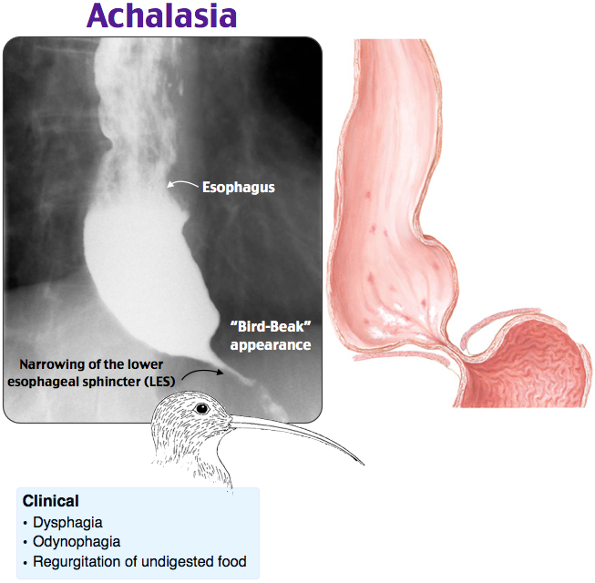
Achalasia
Pathophysiology: Degeneration of inhibitory neurons in the myenteric plexus → Loss of nitric oxide (NO)
Unopposed cholinergic (ACh) activity → Incomplete LES relaxation
Chronic outflow obstruction causes:
Proximal Esophageal dilation
Food/saliva retention

Slide 46

Achalasia: Presentation
Dysphagia to solids & liquids
Regurgitation
Nocturnal cough
Chest discomfort
Weight loss

Slide 47

Achalasia: Evaluation
Barium Swallow:
Dilated esophagus + Bird Beak Narrowing
High-resolution manometry (Gold standard)
EGD
Used to exclude obstructing tumor

Slide 48
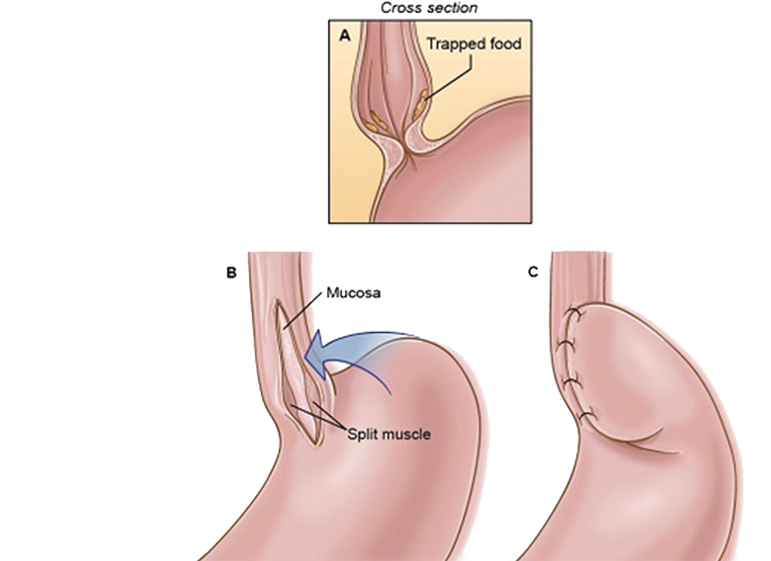
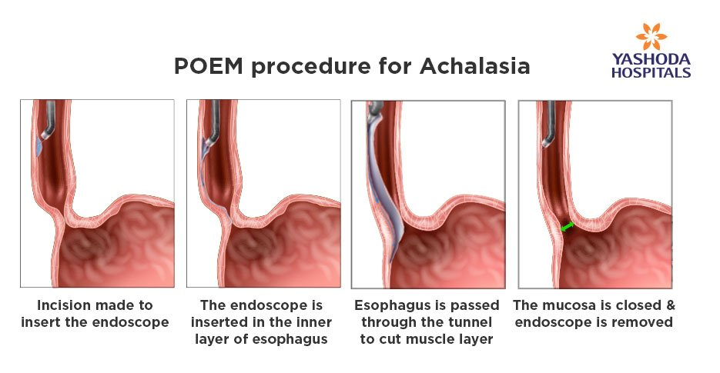
Achalasia: Treatment
Goal: reduce EG junction resistance (cannot restore normal innervation)
Pneumatic dilation
Heller myotomy
Botox
If pt not good surgical candidate
POEM (Peroral endoscopic myotomy)
Heller Myotomy
Notes:
Always assess symptoms post treatment to ensure resolution. Last resort is esophagectomy.

Slide 49
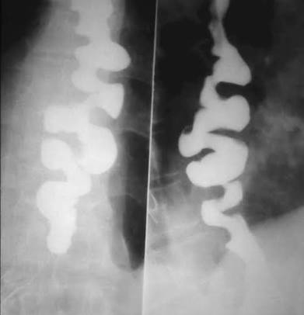
Diffuse Esophageal Spasm
Impaired inhibitory neural signaling → premature contractions
LES relaxation is preserved!! (unlike achalasia)
Presentation:
Dysphagia to solids & liquids
Episodic chest pain
Sx may be triggered by very hot/cold liquids
Diagnosis:
Barium swallow →corkscrew appearance
Manometry:
Normal EGJ relaxation
Premature contractions in atleast 20% of swallows

Slide 50
Diffuse Esophageal Spasm: Treatment
Smooth muscle relaxants:
Calcium channel blockers (CCBs)
Nitrates
Exclude cardiac disease
Tx concurrent reflux
POEM only for refractory cases

Slide 51
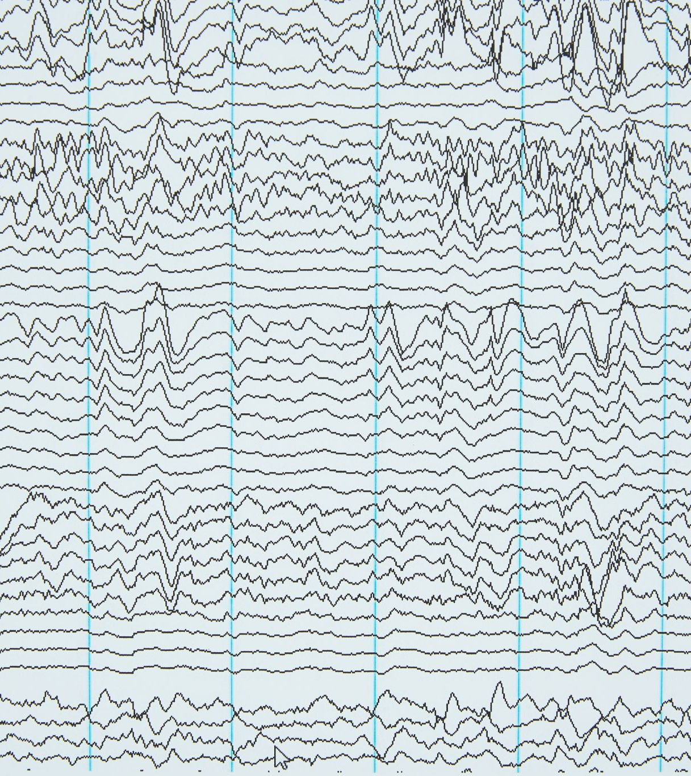
Hypercontractile Esophagus
Excessive vigorous contractions
Tx symptoms rather than manometry numbers

Slide 52
Achalasia
Impaired LES relaxation
Solids & Liquids
Progressive symptoms
Bird Beak appearance
Diffuse Esophageal Spasm
Normal LES relaxation
Intermittent solids and liquids
Chest pain often
Corkscrew appearance

Slide 53
Pseudoachalasia
From a secondary obstruction
Tumor causing extrinsic compression
Esophageal or gastric malignancy
Neurologic injury
Sx:
Rapid sx progression
Marked weight loss
Older age

Slide 54
Zenker Diverticulum

Slide 55
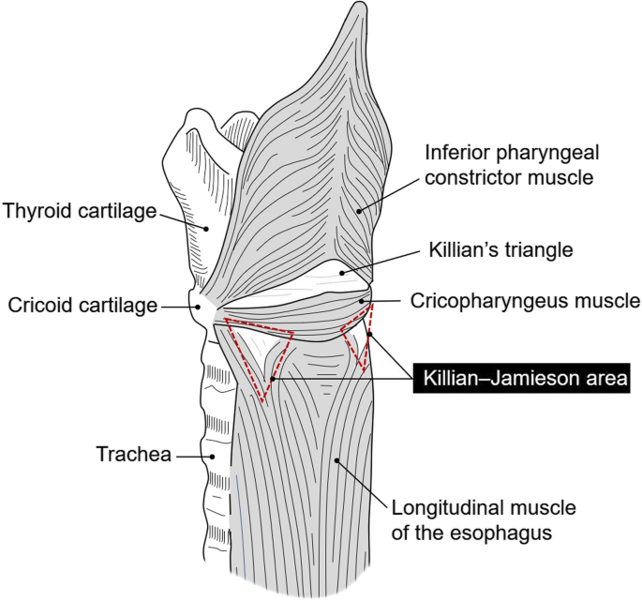
Zenker’s Diverticulum: Pathophysiology
Esophageal diverticulum
Contains mucosa + submucosa (not full esophageal wall)
Forms through Killian’s triangle
Cricopharyngeal dysfunction
Presentation:
Oropharyngeal dysphagia
Regurgitation of undigested food
Halitosis
Coughing after meals

Slide 56
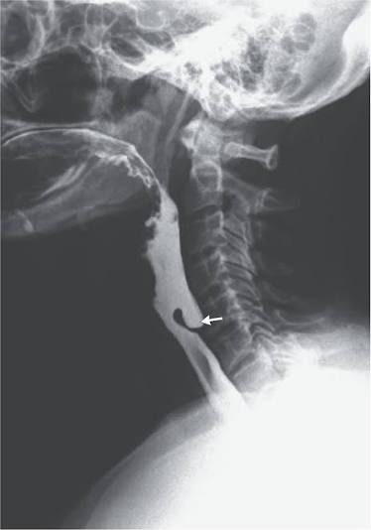
Zenker’s Diverticulum: Pathophysiology
Diagnosis
Barium swallow
Treatment:
Cricopharyngeal myotomy

Slide 57
Esophageal Bleeding Disorders

Slide 58
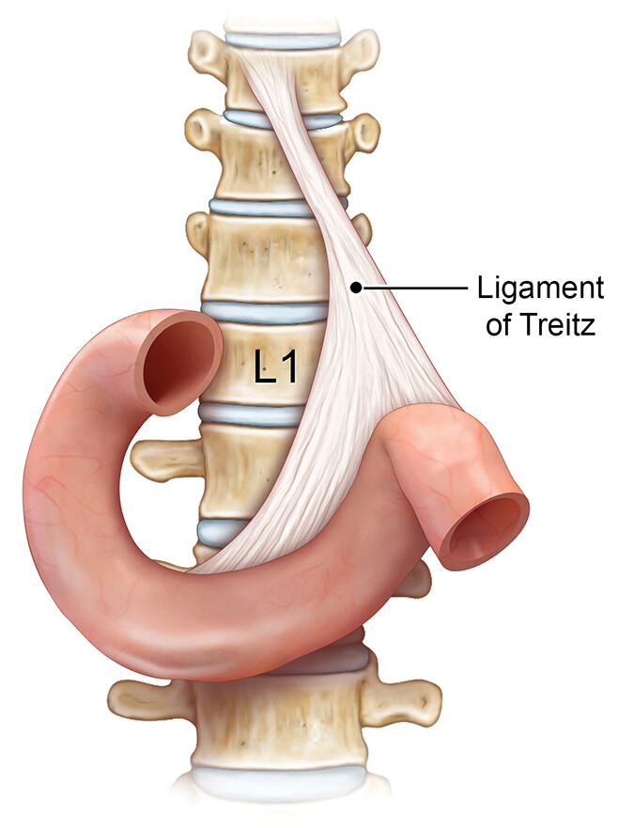
Upper GI Bleeding
Proximal to the ligament of Treitz
Presentation:
Hematemesis
Coffee-ground emesis
Melena
Hematochezia (if rapid/high volume bleeding)
Syncope
Shock
Diagnostics:
Elevated BUN-to-creatinine ratio

Slide 59

Upper GI Bleeding: Causes
Peptic Ulcer Disease
Esophagitis
Esophageal Ulcer
Mallow-Weiss Tear
Boerhaave’s Syndrome
Malignancy

Slide 60
Upper GI Bleeding: Initial Stabilization
Airway > Breathing > Circulation
Two large bore IV’s
Labs:
CBC
CMP
PT/PTT
Type and screen
Treatment:
IV fluids (crystalloids) + packed RBC transfusion
Hemoglobin threshold of 7g/dL for most patients, if actively bleeding, then 8mg/dL
Call GI for an EGD!

Slide 61
Mallory-Weiss Tear
Pathophysiology: Sudden rise in intragastric pressure during retching/vomiting → longitudinal mucosal laceration near the GE junction
S/S: repetitive vomiting
Heavy alcohol exposure
Pregnancy associated hyperemesis
Eating disorders

Slide 62
Mallory-Weiss Tear: Diagnosis & Treatment
EGD
Tx:
Supportive care + PPI
EGD → endoscopic clipping, thermal therapy

Slide 63
Boerhaave’s syndrome
Full thickness tear with esophageal perforation
Chest pain, mediastinitis, systemic symptoms
GI Emergency!

Slide 64
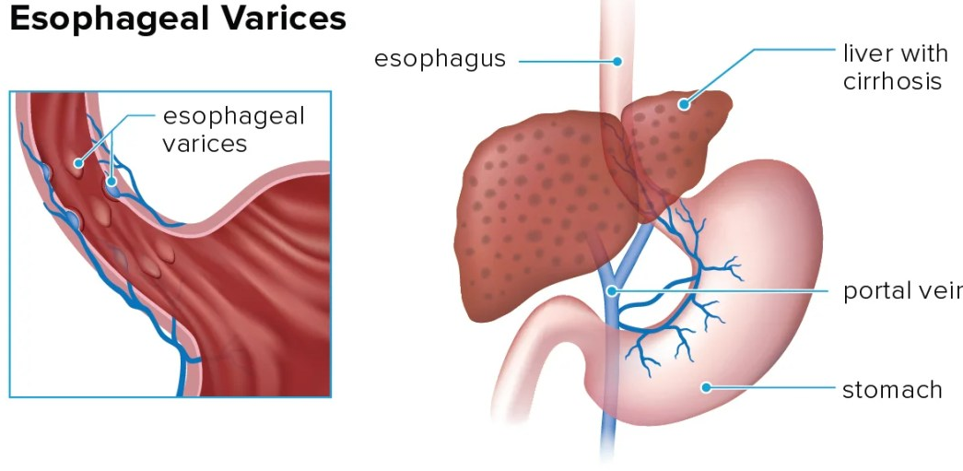
Esophageal Varices
Pathophysiology: cirrhosis → resistance to portal flow → portal hypertension → distal esophageal veins enlarge
Rupture risk!
Typically seen in advanced liver disease
Screening: EGD in newly diagnosed cirrhotics
Tx:
Primary prophylaxis: Nonselective beta blockers
Propranolol, nadolol, carvedilol

Slide 65
Acute Variceal Hemorrhage
Resuscitate!!!
ABCS, IV fluids, pRBC transfusion
Start therapy:
Octreotide – reduces portal hypertension by inhibiting splanchnic vasodilation
Antibiotic prophylaxis: Ceftriaxone
Stabilize → emergent EGD
Can temporize with Balloon tamponade (Blakemore Sengstaken Tube)
PPI to reduce acid
Notes:
Abx due to ability of bacteria to translocate

Slide 66
Peptic Ulcer Disease

Slide 67
Peptic Ulcer Disease
Causes:
H pylori
NSAIDs/aspirin
Critical illness
Smoking
Zollinger-Elison, viral ulcers, Crohn’s disease
Mucosal break in stomach or duodenum due to acid injury

Slide 68
Peptic Ulcer Disease Sx
Burning/gnawing epigastric pain
Dyspepsia
Early satiety
Nausea
Alarm features:
GI bleeding or anemia
Unintentional weight loss
Progressive dysphagia
Older patient w/ new or progressive sx

Slide 69
Peptic Ulcer Disease: H. Pylori
H pylori is a gram negative organism that survives in the gastric mucus layer
Creates urease → urea into ammonia → less acidic environment
Attaches to gastric epithelial cells
Diagnosis:
Urea breath test
Stool antigen test
Make sure you dc any PPIs for at least 4 weeks!!
EGD

Slide 70
Peptic Ulcer Disease: H. Pylori Treatment
Quadruple therapy for 14 days:
PPI BID
Bismuth 4x daily
Tetracycline 500mg 4x daily
Metronidazole 500mg 4x daily
Confirm eradication
Repeat urea breath test at least 4 weeks after PPI and antibiotics

Slide 71
Peptic Ulcer Disease: Treatment
Stop NSAIDs
Consider COX-2 agent if must continue
PPI for 4-8 weeks
Longer treatment for large or complicated ulcers
Test for H pylori

Slide 72
Peptic Ulcer Disease: Complications
Bleeding
Most common
Perforation
Sudden severe abd pain
Free air under diaphgram
Penetration
Ulcer extends into adjacent organ
Posterior duodenal ulcers penetrate into the pancreas
Gastric outlet obstruction
Inflammation/scarring near the pylorus
Malignancy

Slide 73
Diagnostic Pathway Summary
Heartburn without alarm sx
Empiric PPI
Heartburn with alarm sx
EGD
Progressive solid dysphagia
EGD and biopsy
Solids and liquid dysphagia
EGD and/or manometry
Oropharyngeal symptoms
Speech/swallow evaluation and barium swallow
Suspected Zenker
Barium esophagram
Suspected achalasia
Barium esophagram +/- high resolution manometry

Slide 74
High Yield Comparisons
Esophageal vs. oropharyngeal dysphagia
Esophageal: food sticks after initiation
Oropharyngeal: difficulty initiating with coughing or aspiration
GERD versus EoE
GERD: heartburn/regurgitation
EoE: food impaction/intermittent solid dysphagia
Peptic stricture versus cancer
Peptic: smooth distal narrowing and long GERD history
Cancer: irregular narrowing, rapid progression, weight loss
Achalasia vs. DES
Achalasia: impaired LES relaxation
DES: preserved LES relaxation with premature contractions
Mallory-Weiss vs. Boerhaave
Mallory-Weiss: mucosal bleeding
Boerhaave: transmural perforation

Slide 75
References
ACG Clinical Guideline: Diagnosis and Management of GERD, 2022
ASGE Guideline on Diagnosis and Management of GERD, 2025
Updated ACG Guideline: Barrett’s Esophagus, 2022
ACG Clinical Guideline: Eosinophilic Esophagitis, 2025
ACG Clinical Guideline: Achalasia, 2020
Chicago Classification of Esophageal Motility Disorders v4.0, 2021 ACG Clinical Guideline: Upper GI and Ulcer Bleeding, 2021
AASLD Practice Guidance: Portal Hypertension and Varices, 2024
Current reviews on Zenker diverticulum and Mallory-Weiss syndrome

